Slide 1
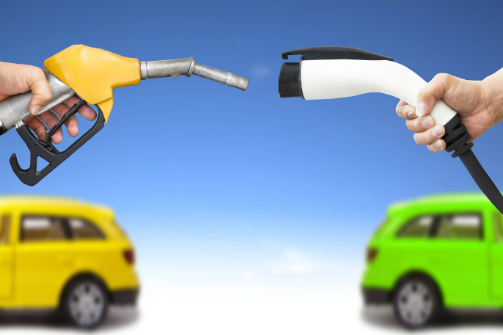
Charge It
Make Green Great Again

Slide 2
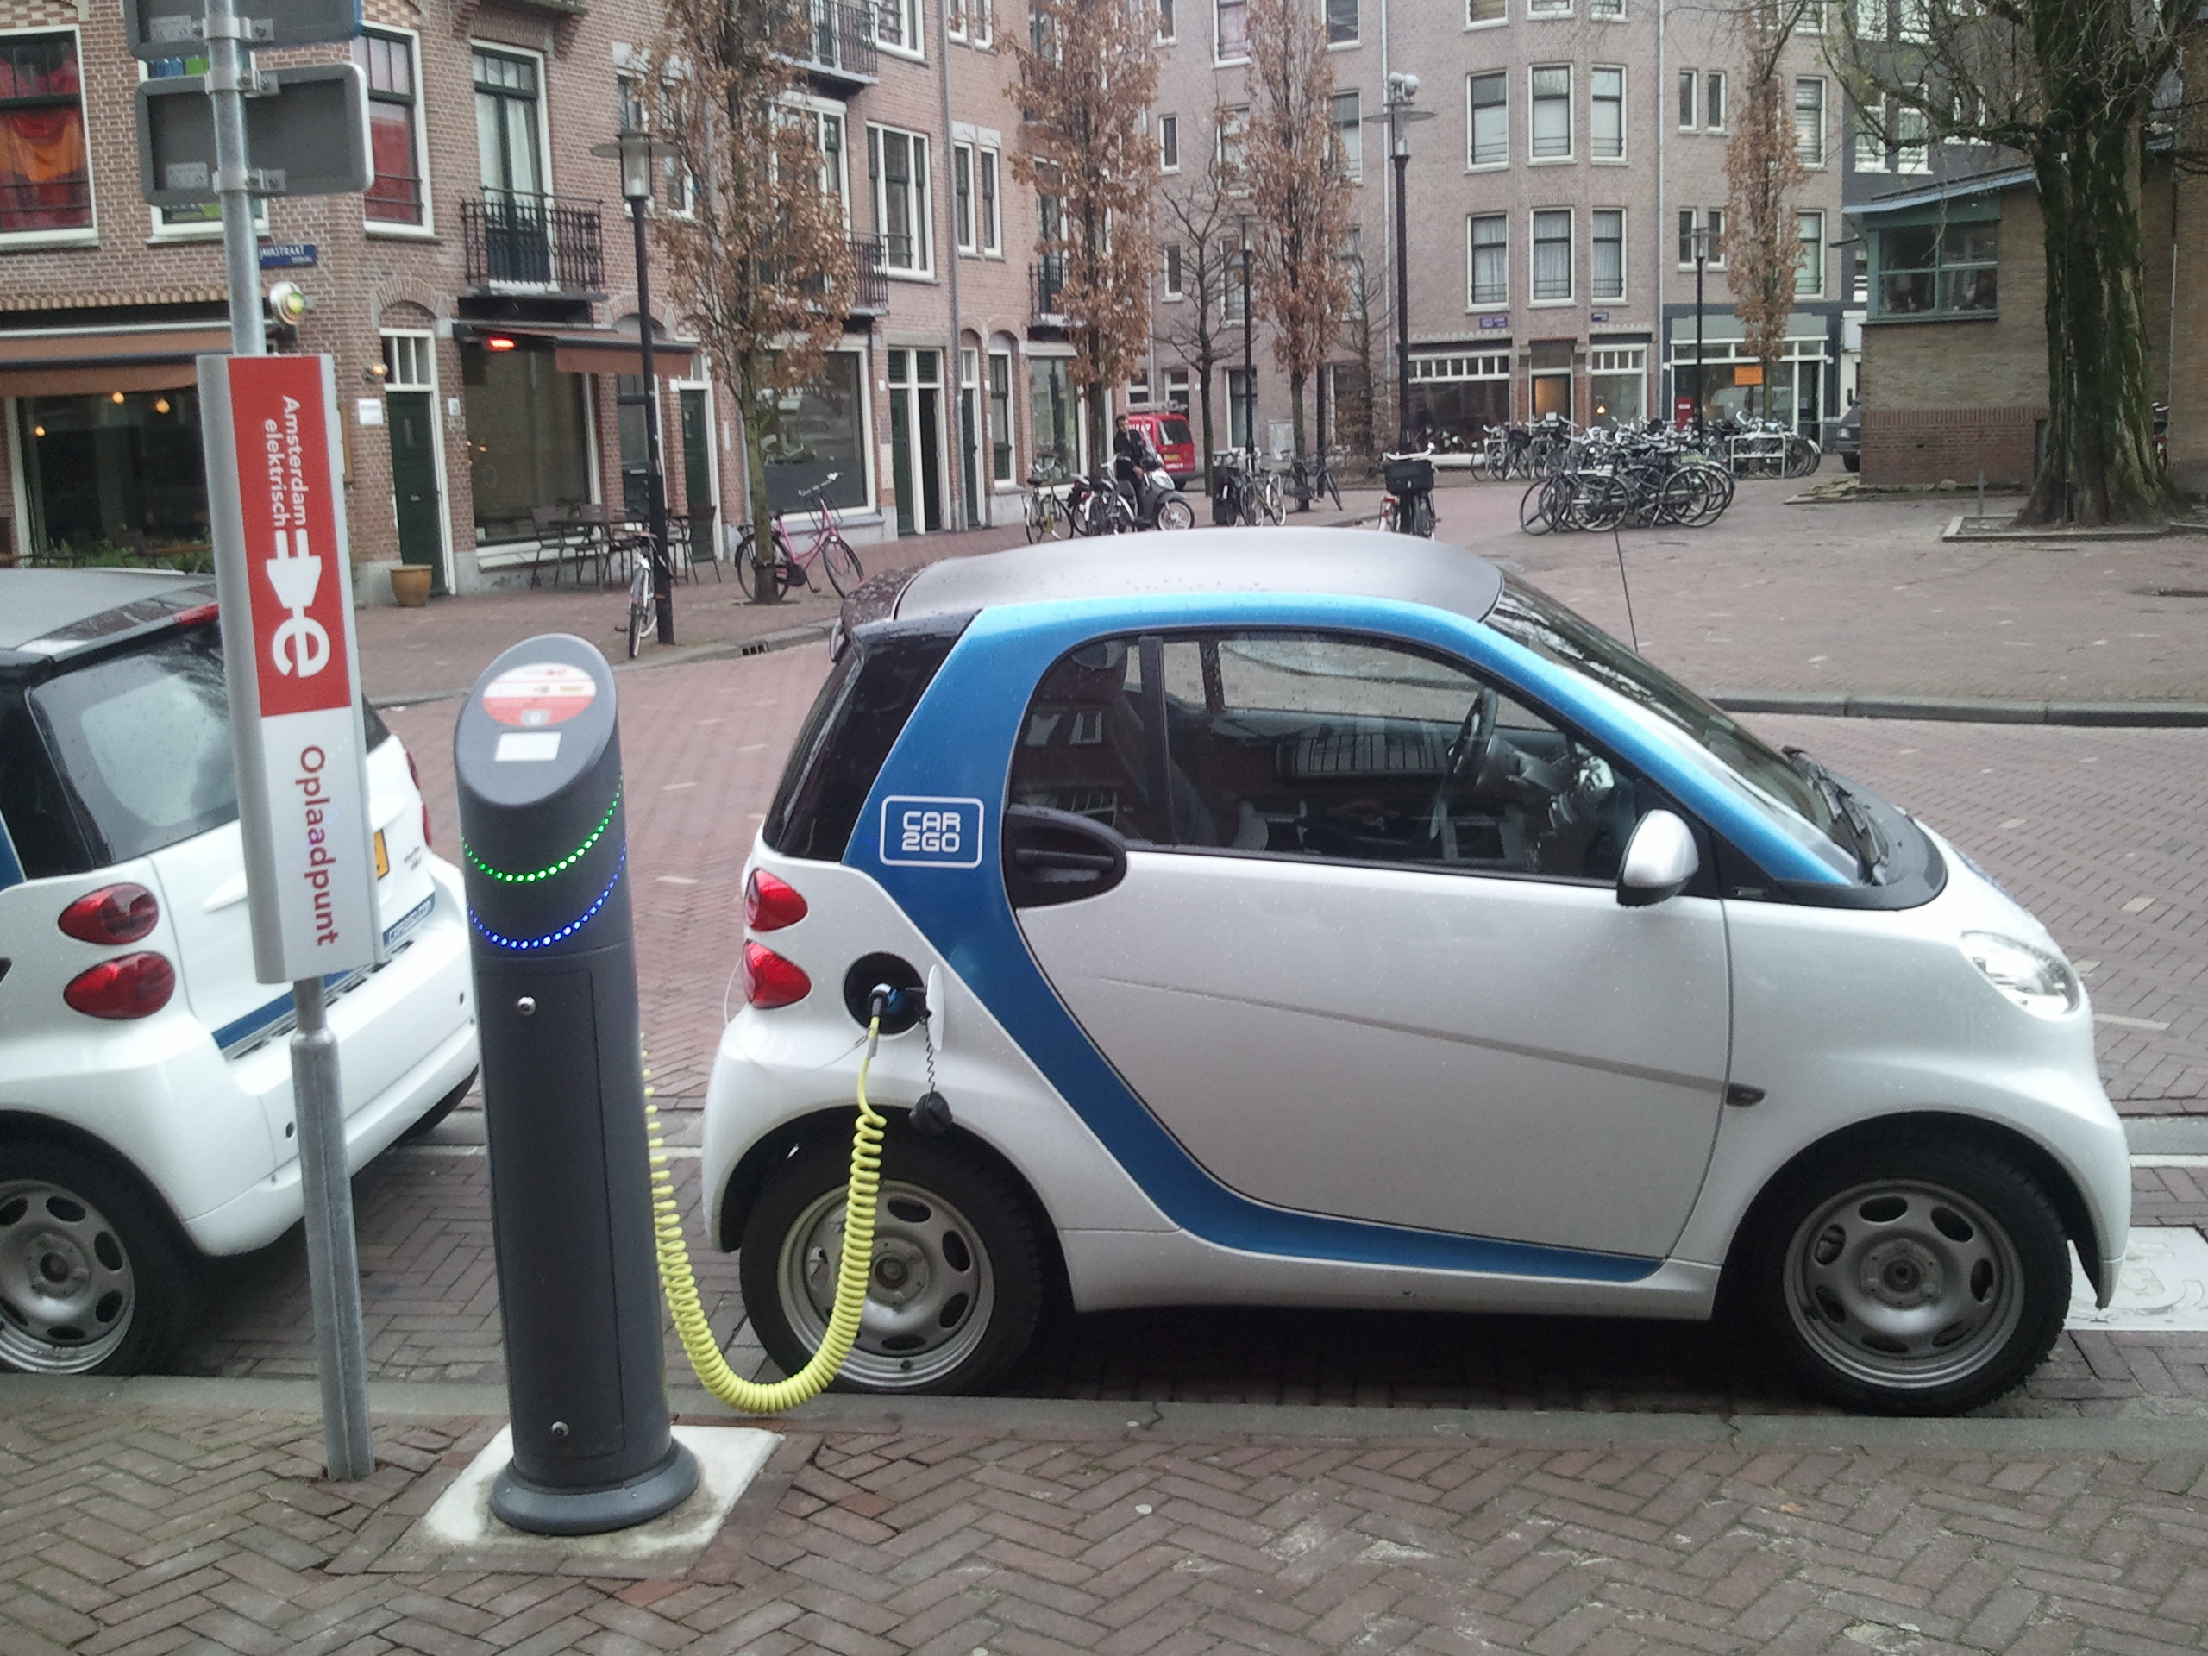

Slide 3
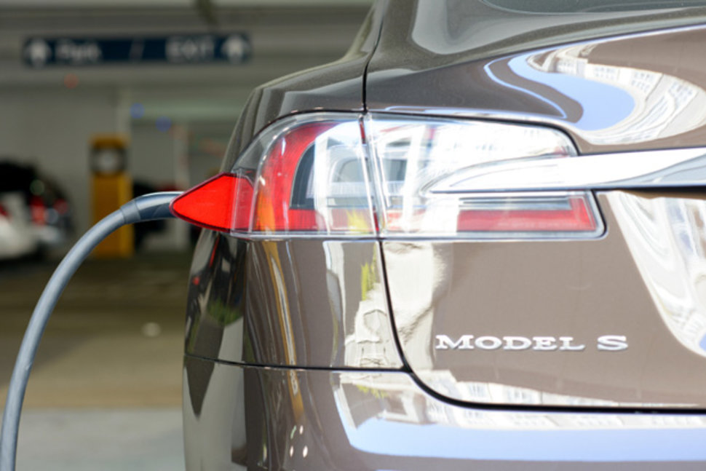

Slide 4
Challenge
Improvements on efficient use of energy
Make cities more sustainable and ecological

Slide 5
Problem
Notes:
Fomos falar com as autoridades competentes e descobrimos que Foram feitos mais de 700 salvamentos só na costa portuguesa

Slide 6
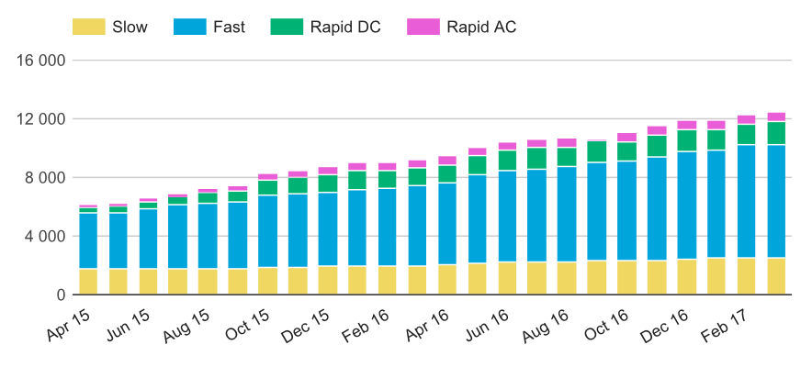
Problem

Slide 7
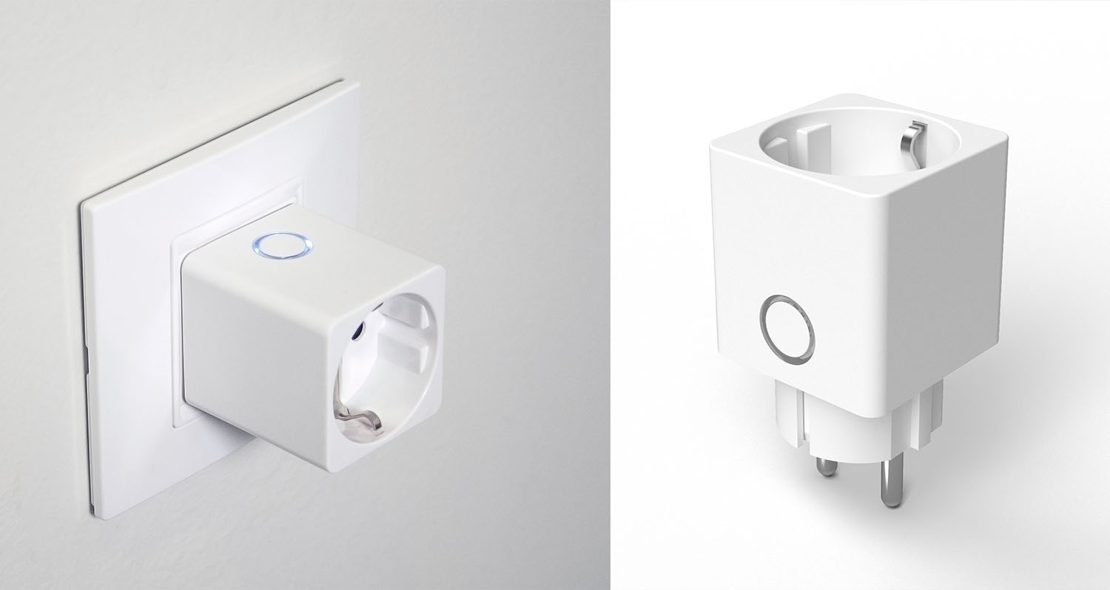
Solution

Slide 8





MVP – Data-flow
Shops/ Home
App

Slide 9
MVP - Features
Data Analytics
Easy Payment by App
Book a Charge
Notes:
Monitorização em tempo real

Slide 10
Notes:
Entregar prototipo

Slide 11
Business Model (1)
Smart Meter
Free
Fee/KWh
60%
Mobile App
Free
Production Cost
10€

Slide 12

Business Model (2)
Estimated
Profit
B2B
B2C
1.6€/h
Per Device!

Slide 13
Thank You

Slide 14
Q&A

